Slide 1
Week 2:
Camera Analogy, Viewing and Modeling Transformations
Computer Graphics with OpenGL

Slide 2
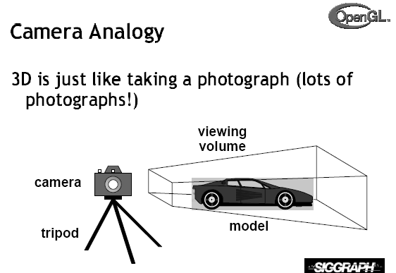

Slide 3
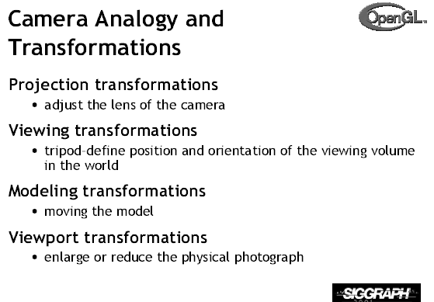

Slide 4
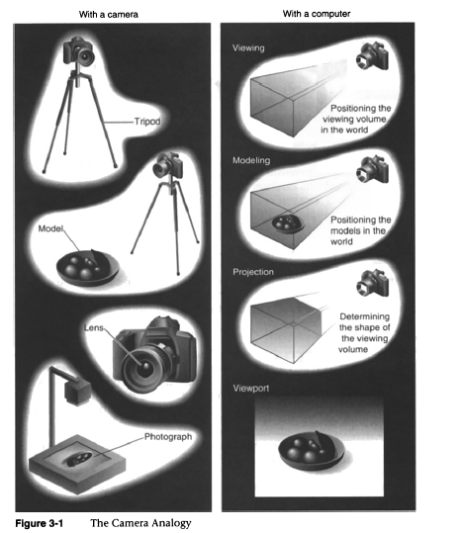

Slide 5
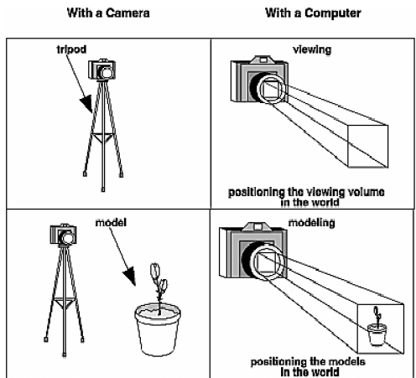

Slide 6
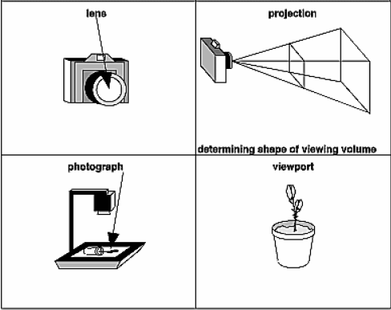

Slide 7
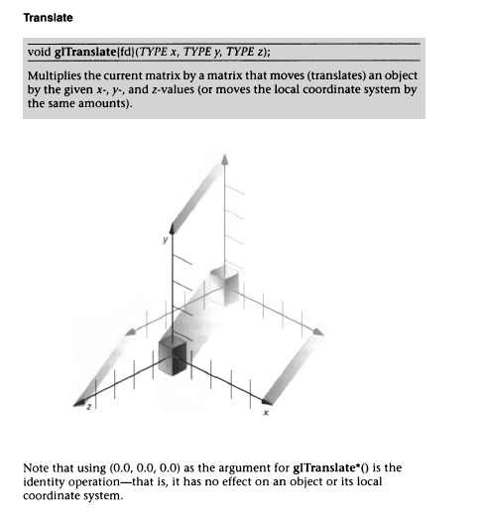
Modeling Transformations

Slide 8
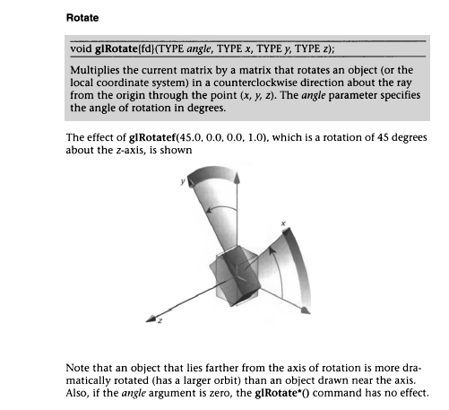

Slide 9
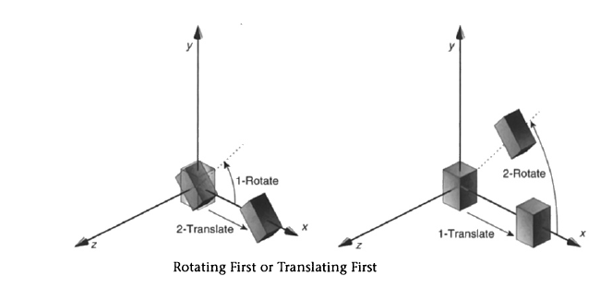

Slide 10
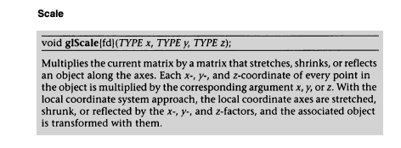
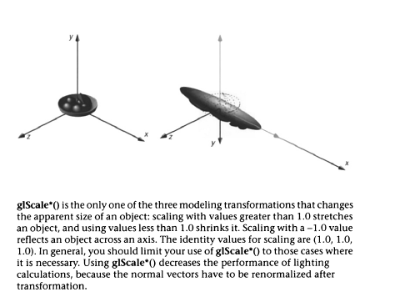

Slide 11
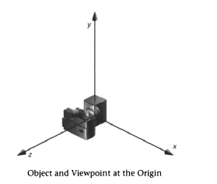
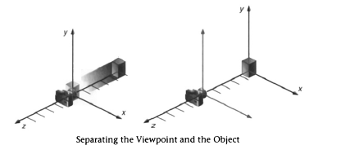

Slide 12
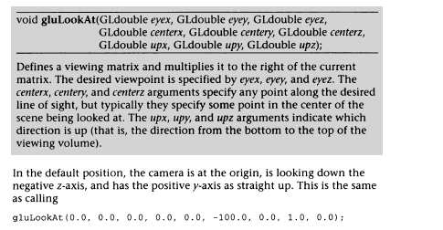

Slide 13
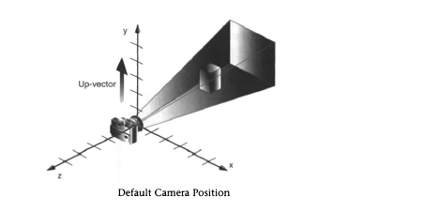

Slide 14
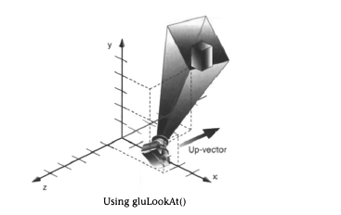

Slide 15
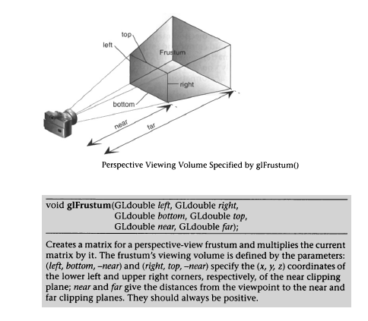

Slide 16
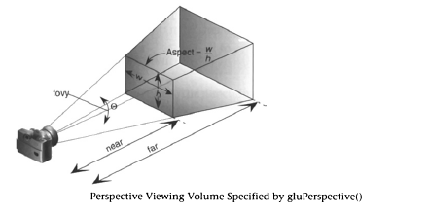
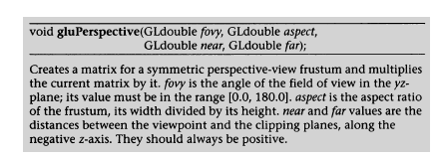

Slide 17
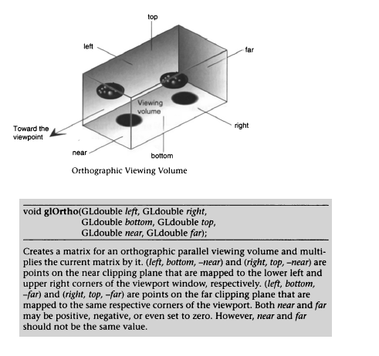

Slide 18
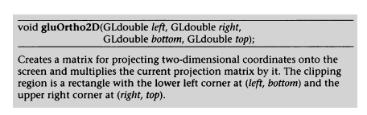

Slide 19
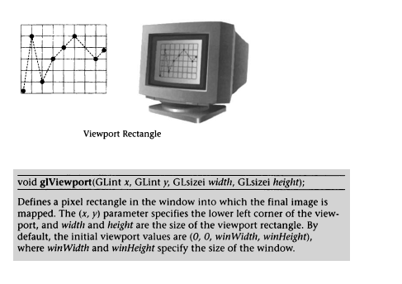

Slide 20
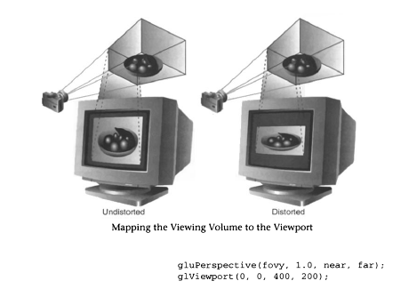


Slide 21
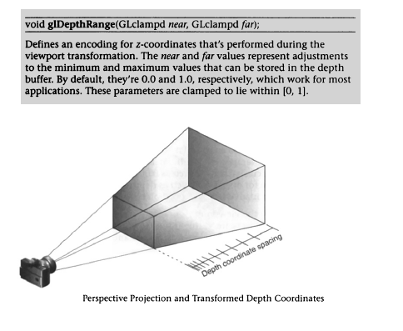

Slide 22
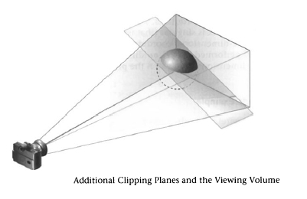
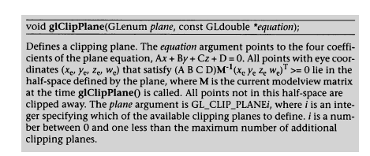

Slide 23
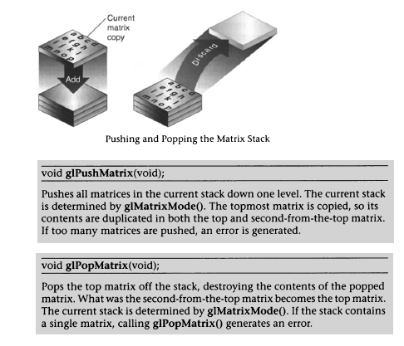
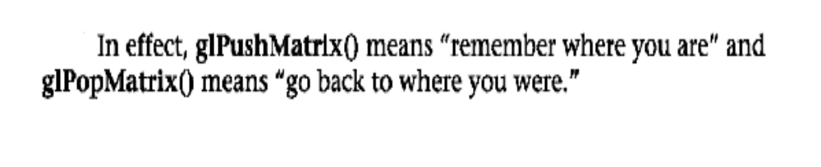

Slide 24
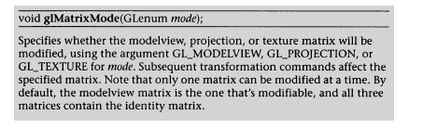

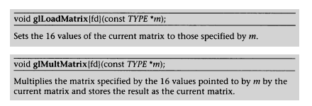

Slide 25
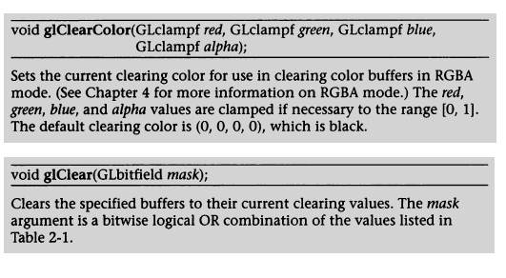

Slide 26
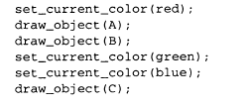
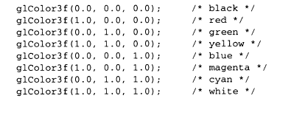

Slide 27
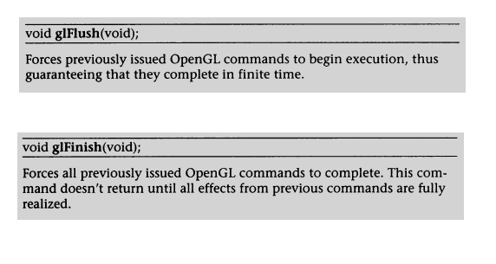
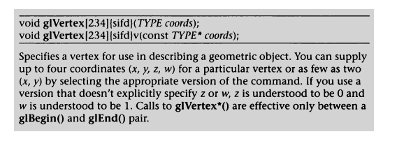

Slide 28
Simple cube
#include <stdlib.h>
#include <glut.h>
void init(void)
{
glClearColor(0.0, 0.0, 0.0, 0.0);
glShadeModel(GL_FLAT);
}
void display(void){
glClear(GL_COLOR_BUFFER_BIT);
glColor3f(1.0, 1.0, 1.0);
glLoadIdentity(); /* clear the matrix */
/* viewing transformation */
gluLookAt(0.0, 0.0, 5.0, 0.0, 0.0, 0.0, 0.0, 1.0, 0.0);
glScalef(1.0, 2.0, 1.0); /* modeling transformation */
glutWireCube(1.0); // glutWireCone(1, 1.0, 8.0, 10);
//glutWireTorus(0.5, 1.0, 10.0, 10);
glFlush();
}

Slide 29
void reshape(int w, int h)
{
glViewport(0, 0, (GLsizei)w, (GLsizei)h);
glMatrixMode(GL_PROJECTION);
glLoadIdentity();
glFrustum(-1.0, 1.0, -1.0, 1.0, 1.5, 20.0);
glMatrixMode(GL_MODELVIEW);
}
int main(int argc, char** argv){
glutInit(&argc, argv);
glutInitDisplayMode(GLUT_SINGLE | GLUT_RGB);
glutInitWindowSize(500, 500);
glutInitWindowPosition(100, 100);
glutCreateWindow(argv[0]);
init();
glutDisplayFunc(display);
glutReshapeFunc(reshape);
glutMainLoop();
return 0;
}

Slide 30
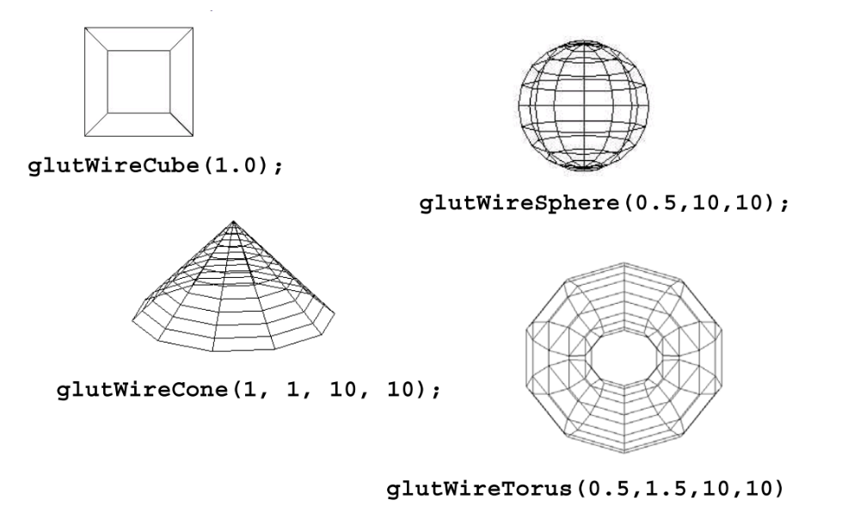

Slide 31
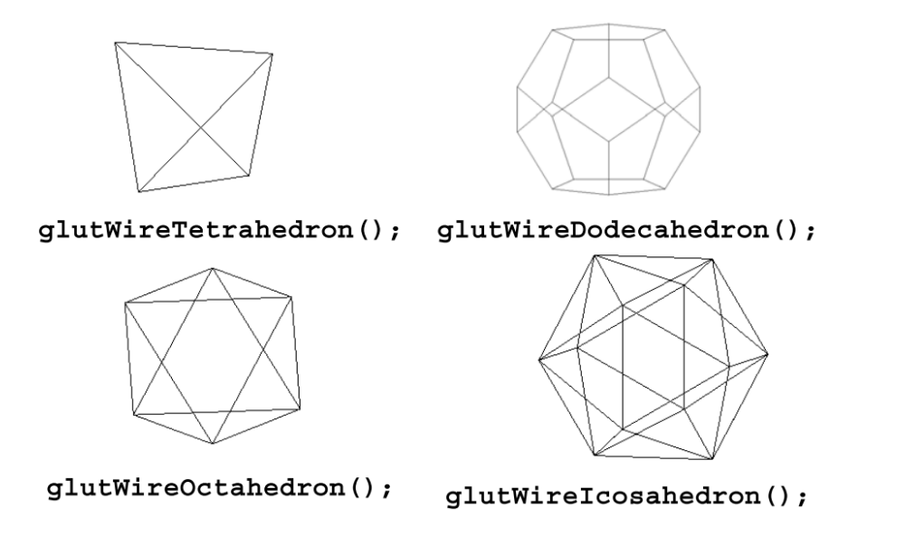

Slide 32
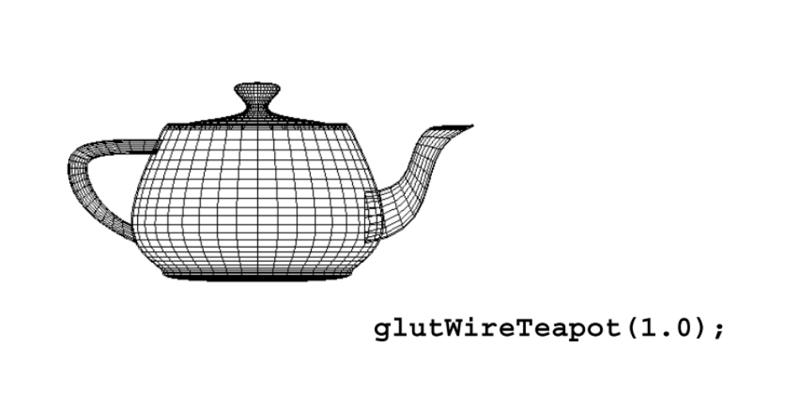

Slide 33
Sun and world:very simple
#include <stdlib.h>
#include <glut.h>
static int year = 0, day = 0;
void init(void){
glClearColor(0.0, 0.0, 0.0, 0.0);
glShadeModel(GL_FLAT);
}
void display(void){
glClear(GL_COLOR_BUFFER_BIT);
glColor3f(1.0, 1.0, 1.0);
glPushMatrix();
glutWireSphere(1.0, 20, 16); /* draw sun */
glRotatef((GLfloat)year, 0.0, 1.0, 0.0);
glTranslatef(2.0, 0.0, 0.0);
glRotatef((GLfloat)day, 0.0, 1.0, 0.0);
glutWireSphere(0.2, 10, 8); /* draw smaller planet */
glPopMatrix();
glutSwapBuffers();
}

Slide 34
void reshape(int w, int h)
{
glViewport(0, 0, (GLsizei)w, (GLsizei)h);
glMatrixMode(GL_PROJECTION);
glLoadIdentity();
gluPerspective(60.0, (GLfloat)w / (GLfloat)h, 1.0, 20.0);
glMatrixMode(GL_MODELVIEW);
glLoadIdentity();
gluLookAt(0.0, 0.0, 5.0, 0.0, 0.0, 0.0, 0.0, 1.0, 0.0);
}

Slide 35
void keyboard(unsigned char key, int x, int y){
switch (key) {
case 'd':
day = (day + 10) % 360;
glutPostRedisplay(); break;
case 'D':
day = (day - 10) % 360;
glutPostRedisplay(); break;
case 'y':
year = (year + 5) % 360;
glutPostRedisplay(); break;
case 'Y':
year = (year - 5) % 360;
glutPostRedisplay(); break;
case 27:
exit(0); break;
default: break;
}
}

Slide 36
int main(int argc, char** argv)
{
glutInit(&argc, argv);
glutInitDisplayMode(GLUT_DOUBLE | GLUT_RGB);
glutInitWindowSize(500, 500);
glutInitWindowPosition(100, 100);
glutCreateWindow(argv[0]);
init();
glutDisplayFunc(display);
glutReshapeFunc(reshape);
glutKeyboardFunc(keyboard);
glutMainLoop();
return 0;
}

Slide 37
Robot arm:
#include <stdlib.h>
#include <glut.h>
static int shoulder = 0, elbow = 0;
void init(void) {
glClearColor (0.0, 0.0, 0.0, 0.0);
glShadeModel (GL_FLAT);
}

Slide 38
void display(void)
{
glClear (GL_COLOR_BUFFER_BIT);
glPushMatrix();
glTranslatef (-1.0, 0.0, 0.0);
glRotatef ((GLfloat) shoulder, 0.0, 0.0, 1.0);
glTranslatef (1.0, 0.0, 0.0);
glPushMatrix();
glScalef (2.0, 0.4, 1.0);
glutWireCube (1.0);
glPopMatrix();
glTranslatef (1.0, 0.0, 0.0);
glRotatef ((GLfloat) elbow, 0.0, 0.0, 1.0);
glTranslatef (1.0, 0.0, 0.0);
glPushMatrix();
glScalef (2.0, 0.4, 1.0);
glutWireCube (1.0);
glPopMatrix();
glPopMatrix();
glutSwapBuffers();
}

Slide 39
void reshape (int w, int h)
{
glViewport (0, 0, (GLsizei) w, (GLsizei) h);
glMatrixMode (GL_PROJECTION);
glLoadIdentity ();
gluPerspective(65.0, (GLfloat) w/(GLfloat) h, 1.0, 20.0);
glMatrixMode(GL_MODELVIEW);
glLoadIdentity();
glTranslatef (0.0, 0.0, -5.0);
}

Slide 40
void keyboard (unsigned char key, int x, int y){
switch (key) {
case 's':
shoulder = (shoulder + 5) % 360;
glutPostRedisplay(); break;
case 'S':
shoulder = (shoulder - 5) % 360;
glutPostRedisplay(); break;
case 'e':
elbow = (elbow + 5) % 360;
glutPostRedisplay(); break;
case 'E':
elbow = (elbow - 5) % 360;
glutPostRedisplay(); break;
case 27:
exit(0); break;
default: break;
}
}

Slide 41
int main(int argc, char** argv)
{
glutInit(&argc, argv);
glutInitDisplayMode (GLUT_DOUBLE | GLUT_RGB);
glutInitWindowSize (500, 500);
glutInitWindowPosition (100, 100);
glutCreateWindow (argv[0]);
init ();
glutDisplayFunc(display);
glutReshapeFunc(reshape);
glutKeyboardFunc(keyboard);
glutMainLoop();
return 0;
}

Slide 42
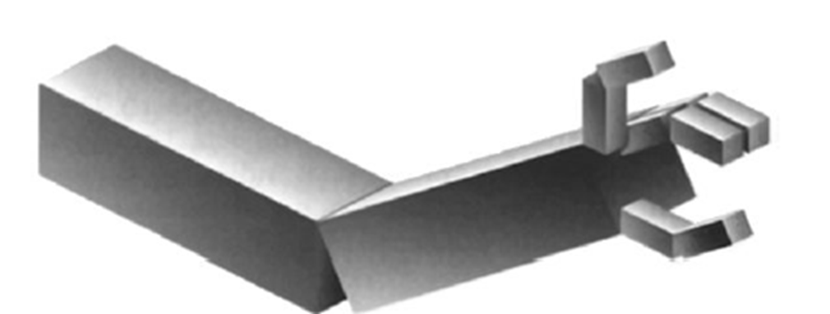
Odev 1
Örnekte çizdiğiniz robot koluna iki parmak ekleyin ve hareket ettirin

